Slide 1
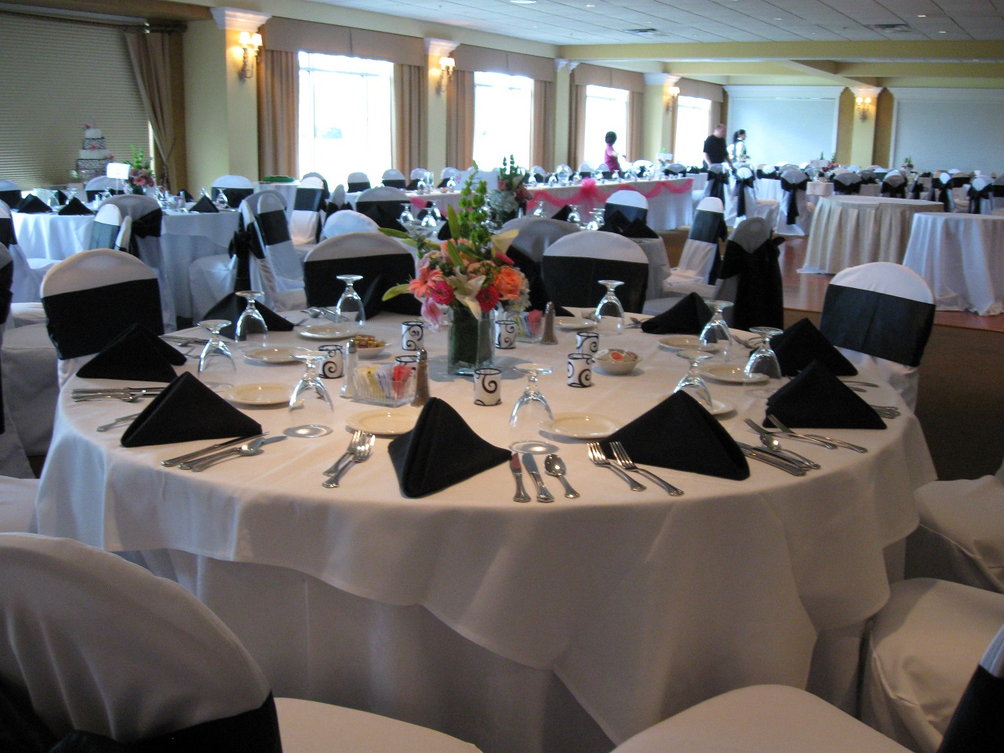

August 3rd, 2021
Presentation

Slide 2
2021 Outlook
With two months remaining in our FY, we are projected to have our 4th consecutive record year financially
We are forecasting our EBITDA to be around $210K
Membership numbers continue to move in a positive direction
We are investing roughly $150K in capital improvements this year alone

Slide 3
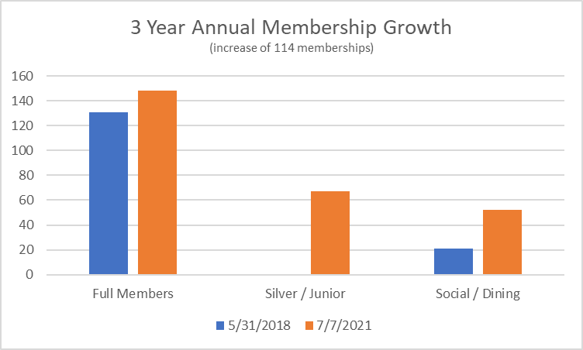

Slide 4
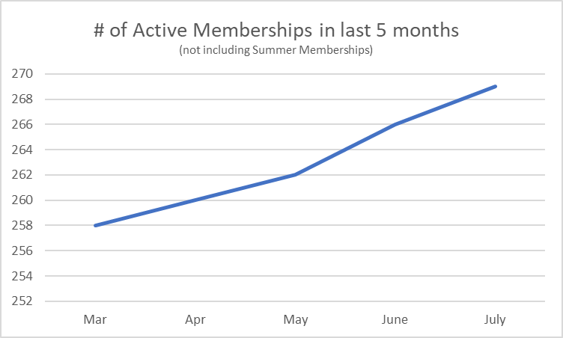

Slide 5
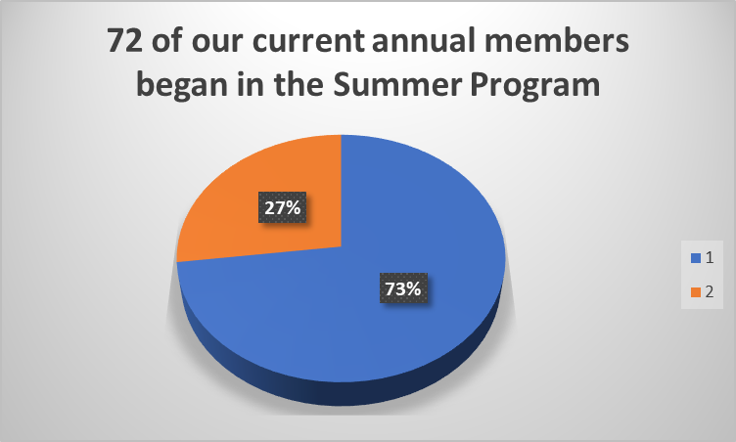

Slide 6
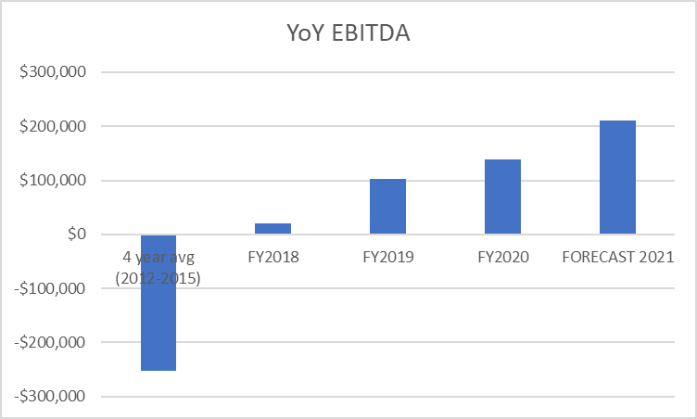

Slide 7

Membership Survey
167 Responses
Facility improvements noted and many are in process (Range Tee, Cart Paths, Rolling of Greens, and Bunkers)
F&B Hours of Operation
  Saturday Night Dinner is coming back
  Extending Sunday kitchen hours to 6pm (adding NFL ticket)
Working to get more creative on Dinner Specials
New F&B Manager (Brandy) is hard at work on new drink menus & social calendar
Extending Pool Hours of Operation
Tee Time Availability on Weekend mornings

Slide 9

Staffing Challenges
Like many other businesses, Eaglebrooke is experiencing a shortage of employees in all departments.
We are still carefully adhering to the CDC guidelines related to COVID. The pandemic does not seem to be going away anytime soon.
Please be patient with us as we work through this challenging time.

Slide 10
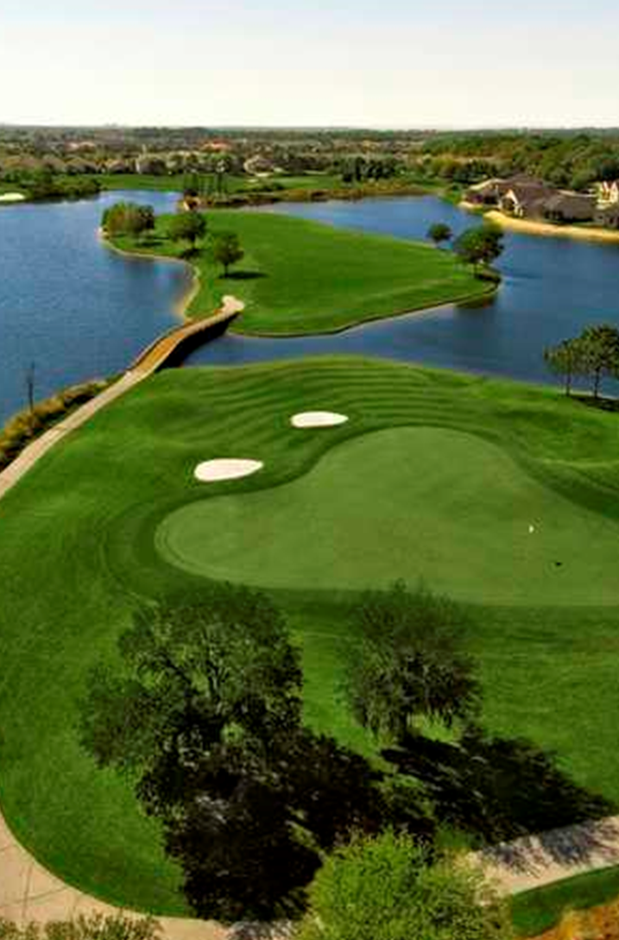
THANK YOU

